Slide 1
Learning basic command

Slide 2
1-Display information about your identity
$ id
Login Identity includes:
user name, group name, user ID, and group ID.

Slide 3
2-Displays who is on the system
$ who
Linux keeps track of login session:
when you logged in, how long you have been idle, and where you logged in from.

Slide 4
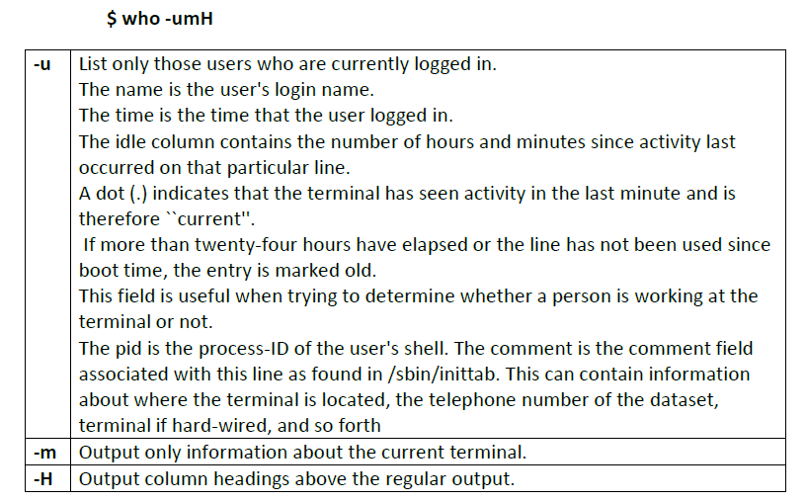

Slide 5
4. print working directory
$ pwd

Slide 6
5- Changing to a different directory
$ cd
typing just cd alone will move you into the home directory
$ cd /etc
To change the current directory to the directory that you choose (ex. /etc )

Slide 7
6-Listing files and directories
$ ls –m
To list files across the page, separated by commas.
. $ ls ~
List the contents of your home directory by adding a tilde after the ls command.
$ ls /
List the contents of your root directory.

Slide 8
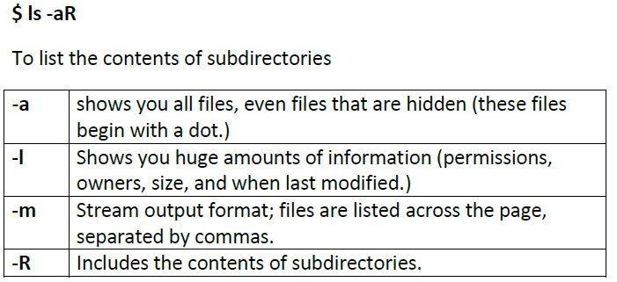

Slide 9
7- Making Directories
$ mkdir directoryName

Slide 10
8-Create empty files
$ touch Filename
When used without any options, touch creates new files for any file names that are provided as arguments
ex.:
The following command would create three new, empty files named file1, file2 and file3:
$ touch file1 file2 file3

Slide 11
9-Moving files
• The command mv moves or renames files.
To rename file:
$ mv oldfilename newfilename
$ mv abc1 abc2
It will rename the file abc1 to a new name abc2
To move a file to a directory. use (mv) in the following form:
$mv filename directoryname
It will move the file into the named directory keeping its old name.
$ mv abc2 /home/ubuntu/test
Move abc2 file to test directory

Slide 12
10-Copying files
$ cp filename directoryname

Slide 13
11-Deleting files
$ rm filename

Slide 14
12-compresses files
gzip filename
compresses files, so that they take up much less space. Usually text files compress to about half their original size, but it depends very much on the size of the file and the nature of the contents. There are other tools for this purpose, too (e.g. compress), but gzip usually gives the highest compression rate. Gzip produces files with the ending '.gz' appended to the original filename.

Slide 15
13-uncompresses files
gunzip filename
uncompresses files compressed by gzip.

